Slide 1
https://codeburst.io/algorithms-i-searching-and-sorting-algorithms-56497dbaef20

Slide 2
CSS143 Computer Programming (II)

Slide 3
Homework 1 Review

Slide 4
Source Control in Slides

Slide 5
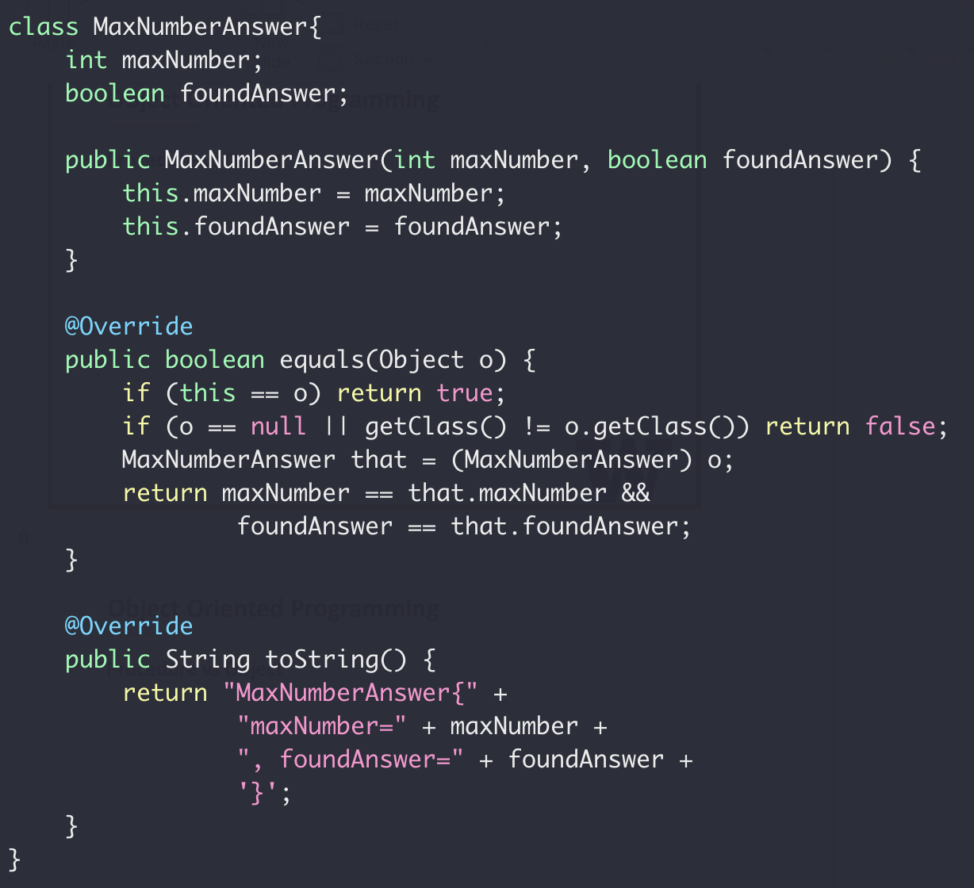
Object Oriented Programming
Find the maximum number in an array
Return value:
Max value
IsValid

Slide 6
Object Oriented Programming
Class
Variables
Variables
Methods
Methods
A class is a type like
int, float, boolean

Slide 7
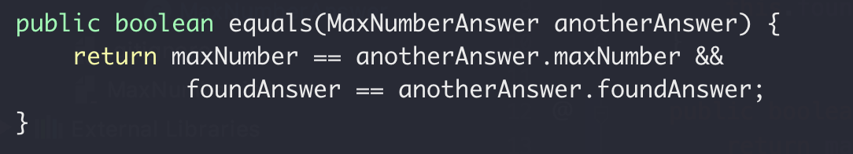
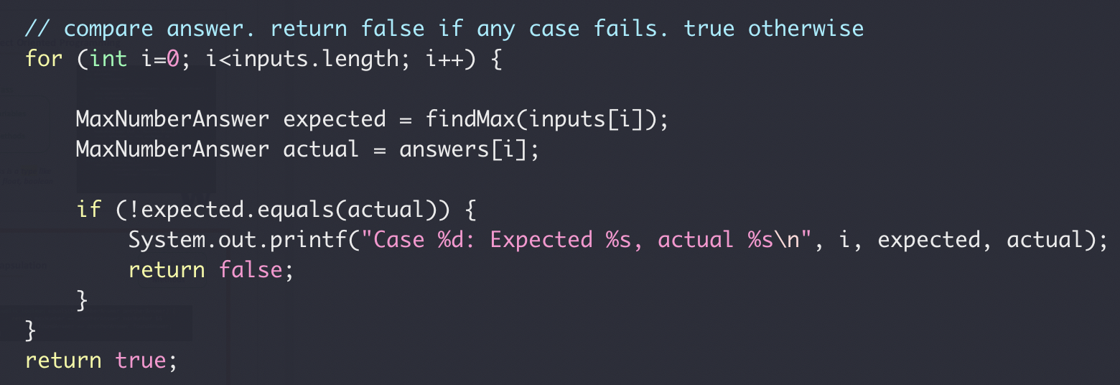
Encapsulation
Class
Variables
Methods
MaxNumberAnswer.equals(…)
testFindMax()

Slide 8
Class vs Object vs Instance vs Reference

Slide 9
Class Exercise
Implement a class for cats
Member Variables:
Name
Gender
Age
Member Methods:
Speak
Play

Slide 10
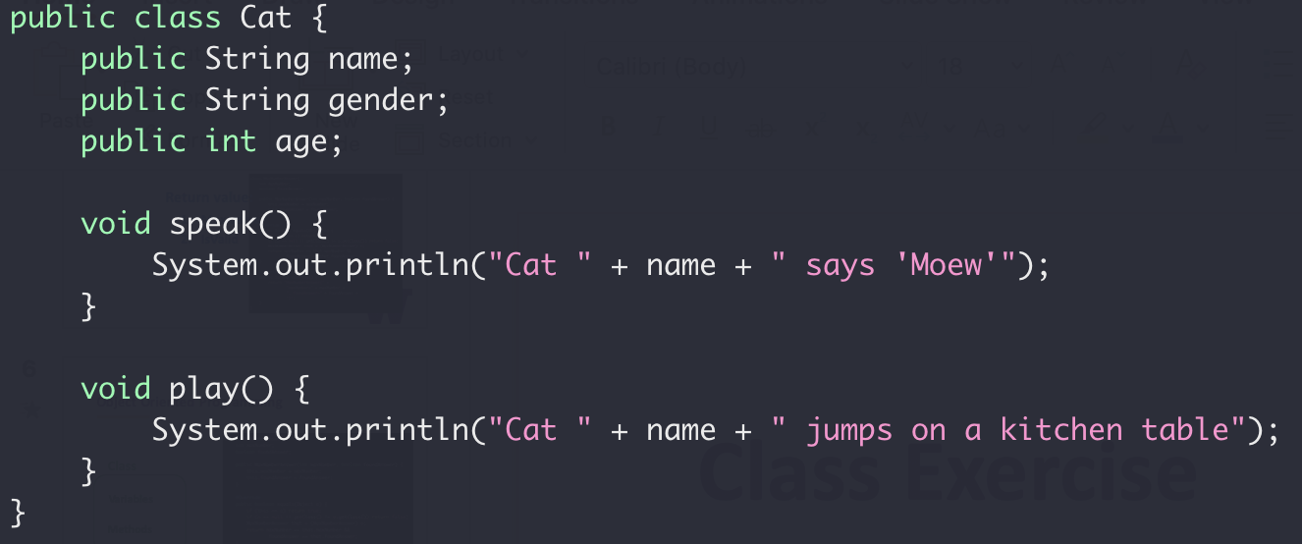
Class Exercise
Implement a class for cats

Slide 11
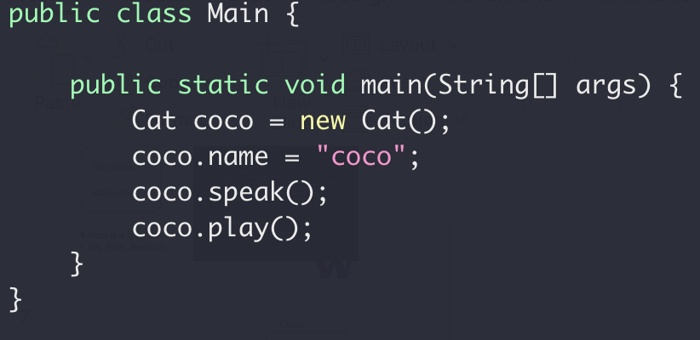
Class Exercise
Implement a class for cats

Slide 12
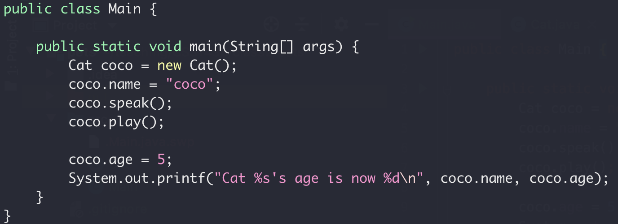
Encapsulation
Nop!
Your age is 5.
Me
☹

Slide 13
Encapsulation
Class
Variables
Variables
Access
public Methods
Methods
Setter/Getter
Read/Write
private Methods

Slide 14
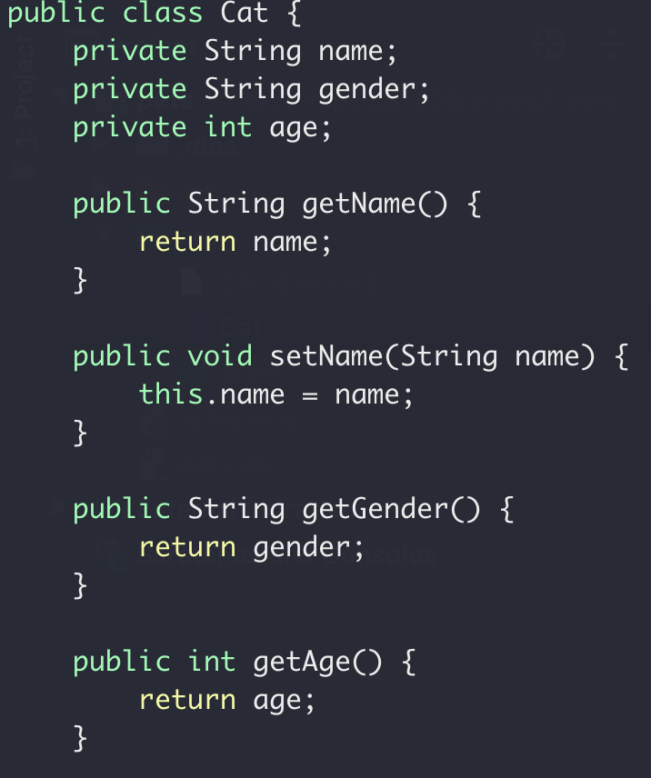
Class Exercise
Setter and Getter

Slide 15
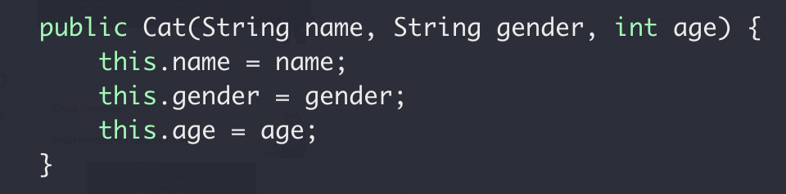
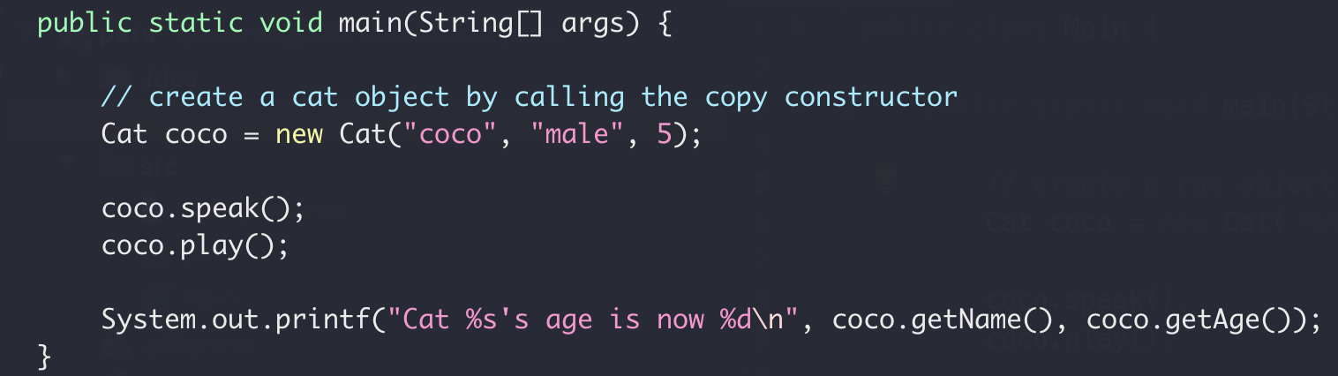
Class Exercise
Copy Constructor

Slide 16
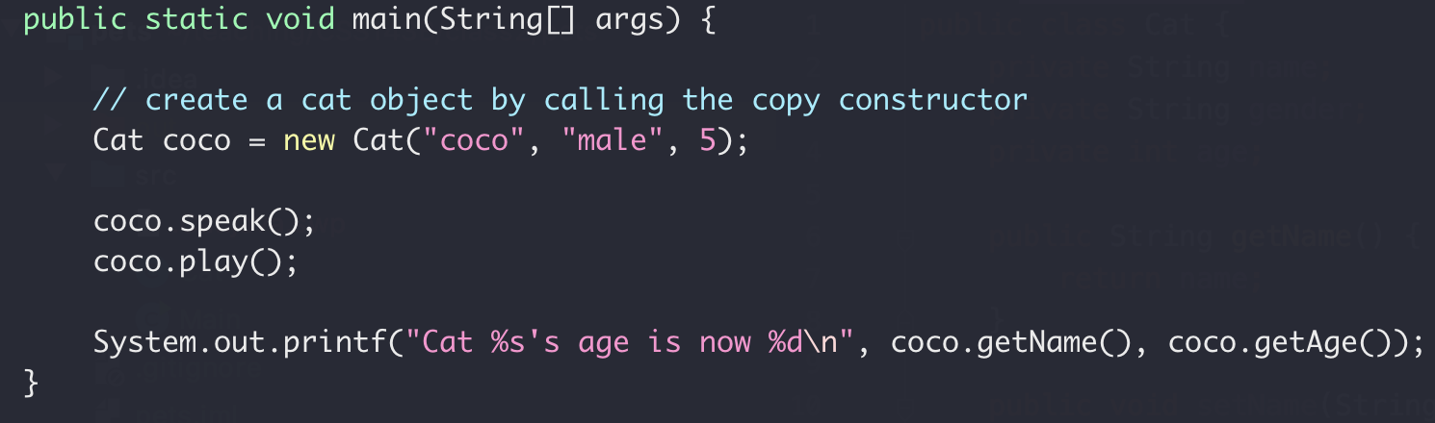
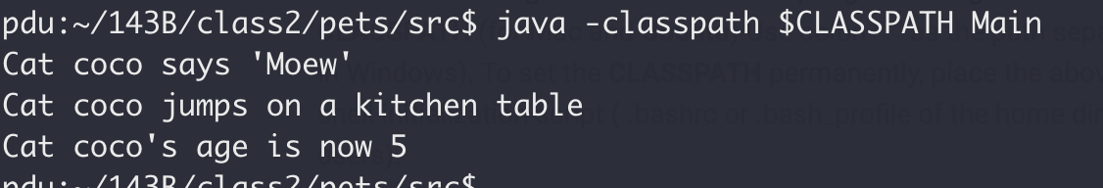

Class Exercise
Full code here version 0

Slide 17
Encapsulation Summary
Group properties (variables) and methods (that work on properties) into a single concept call “class”
Group properties (variables) and methods (that work on properties) into a single concept call “class”
Member variables should be private (not exposed to outside)
Member variables should be private (not exposed to outside)
What’s the default access level? Public or private?
Constructor to set/initialize members when creating object
Constructor to set/initialize members when creating object
Setter/getter for member properties access

Slide 18
Class Exercise
Implement a class for dogs
Member Variables:
Name
Gender
Age
Member Methods:
Speak
Play

Slide 19
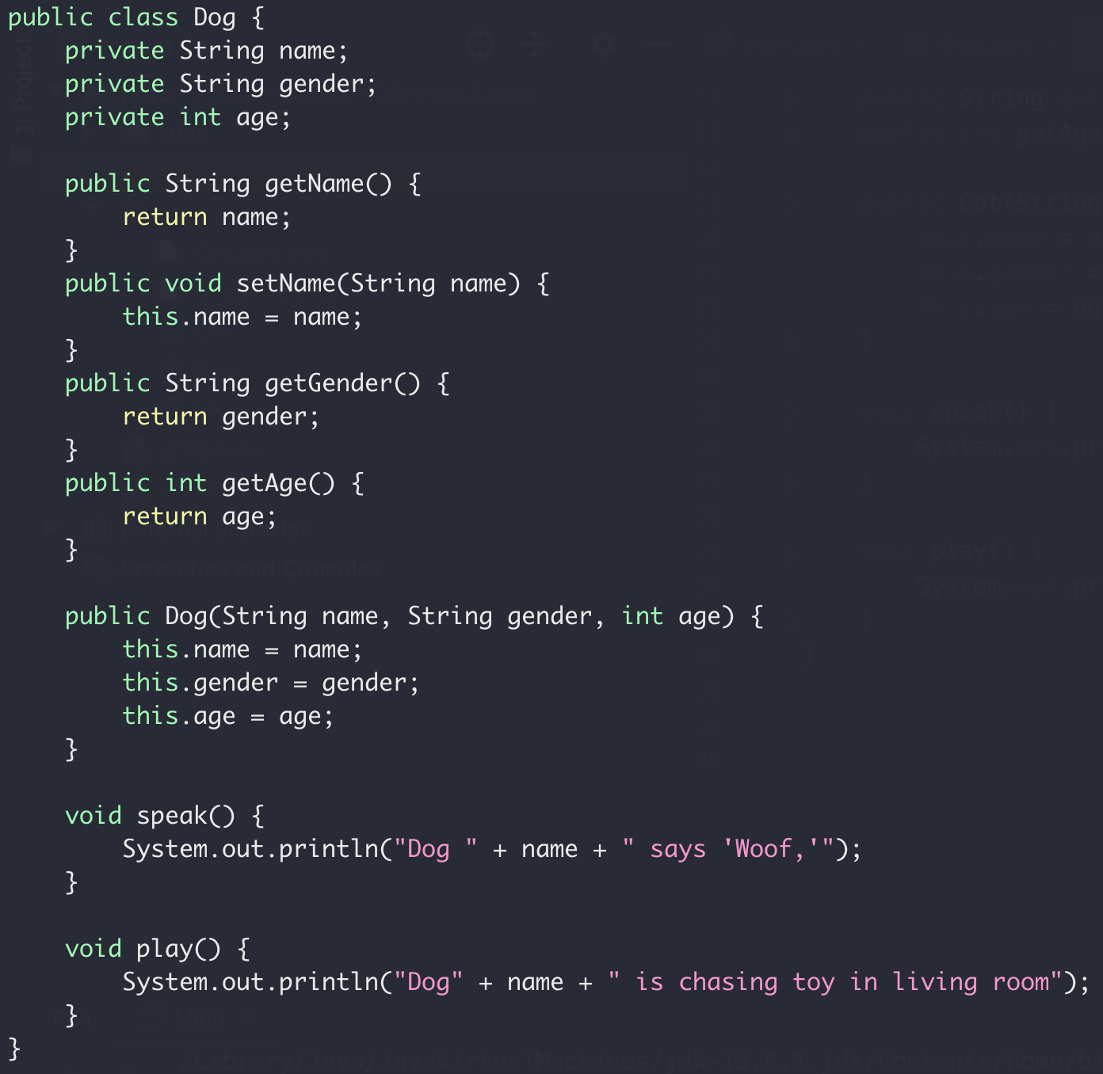
Class Exercise
Implement a class for dogs

Slide 20
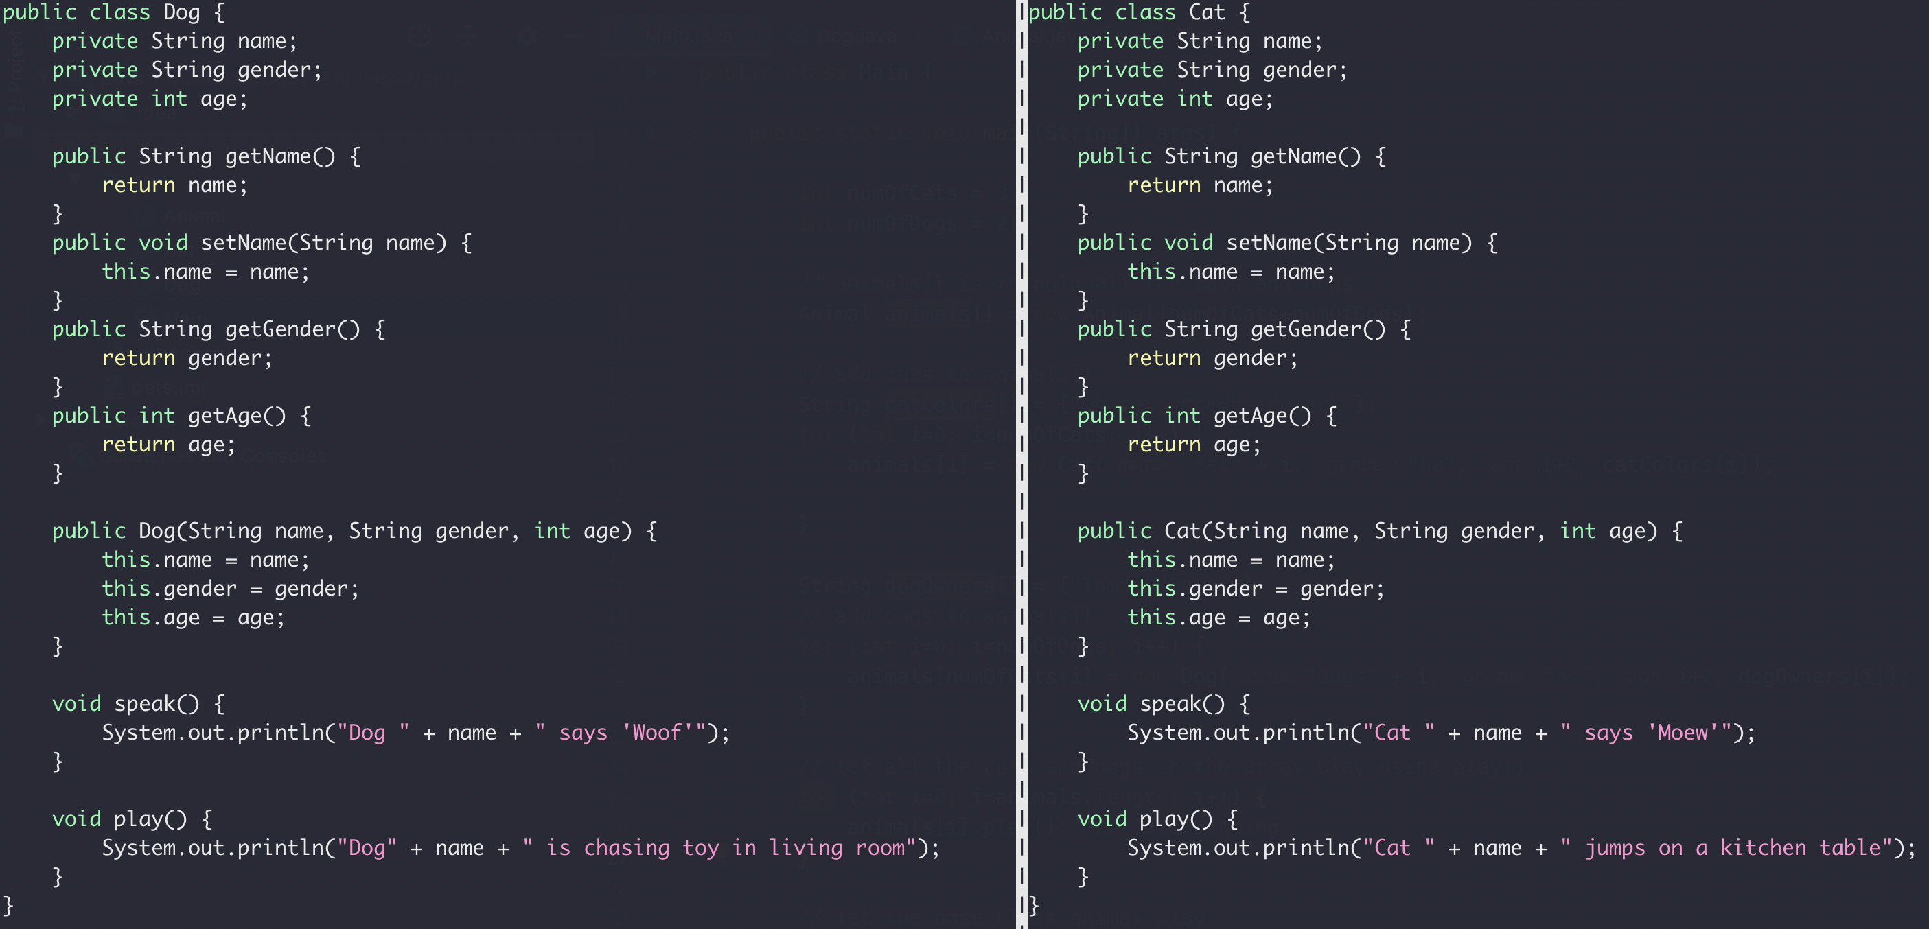
Inheritance
Compare the Cat and Dog class
Duplicated

Slide 21
Inheritance
Animal Class
Name
Gender
Age
Dog Class
Cat Class
Name
Gender
Age
Name
Gender
Age

Slide 22
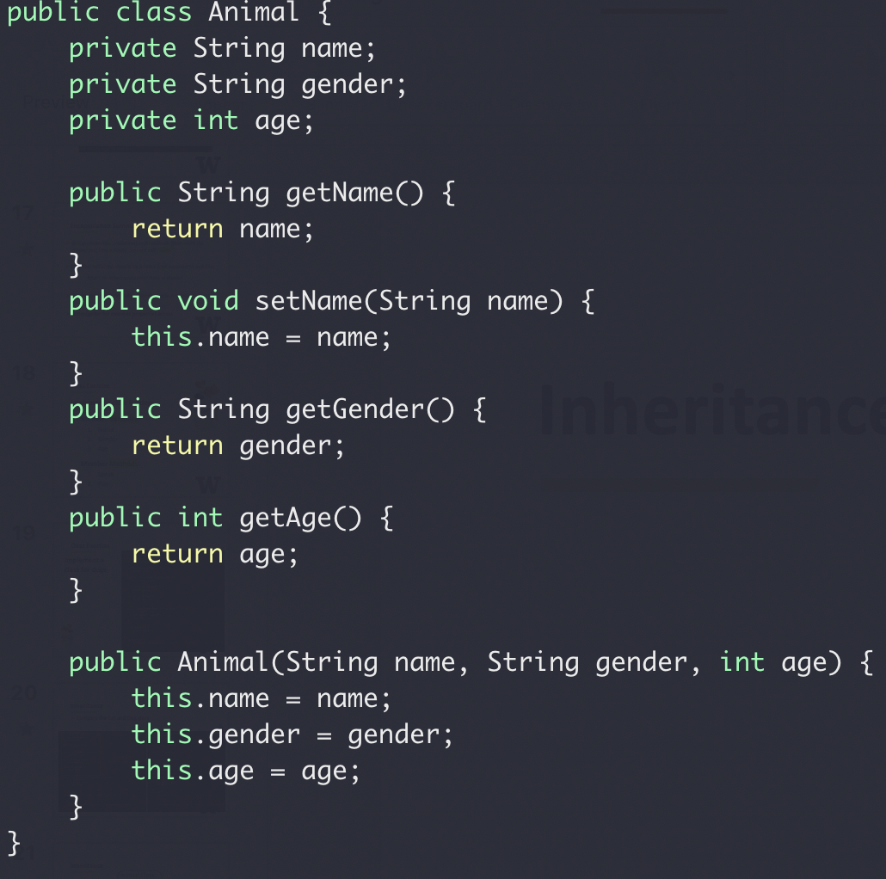
Inheritance
Animal Class
Name
Gender
Age
Base class constructor

Slide 23
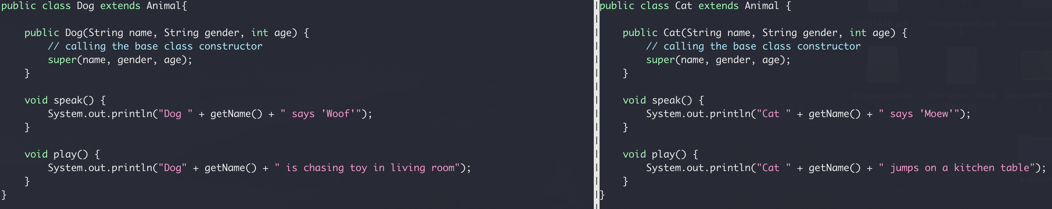
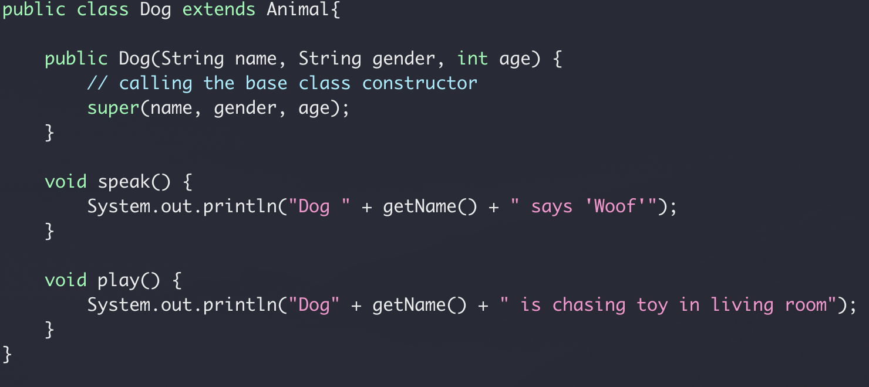
Inheritance
Compare the Cat and Dog class
inheritance
Calling based class constructor
Full code here version 1

Slide 24
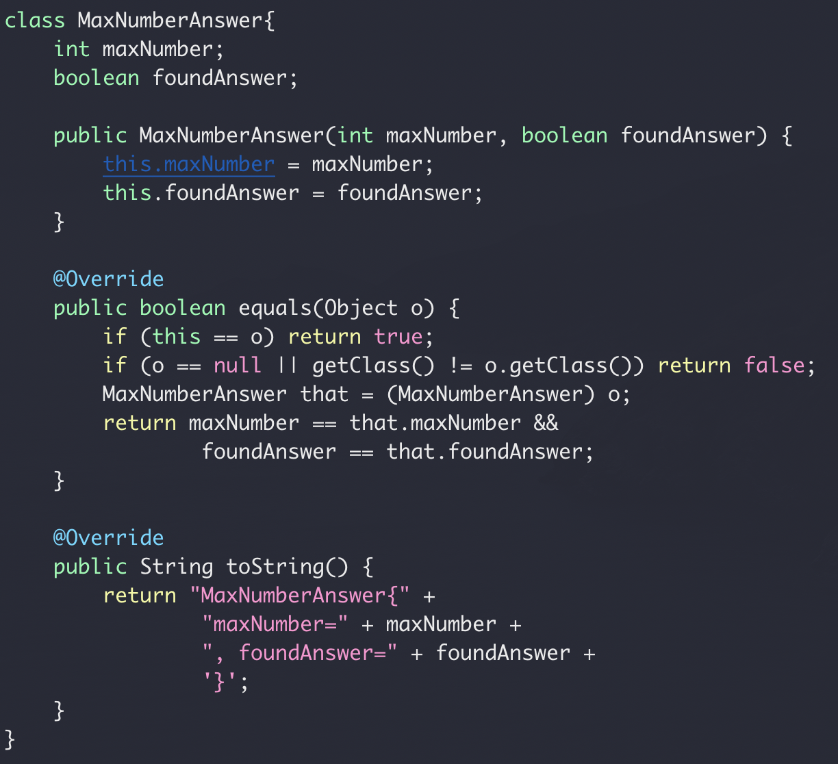
Inheritance
In Java, all classes are derived from the Object class
Yes, your own class too!
Override of the Object class equal() and toString()

Slide 25
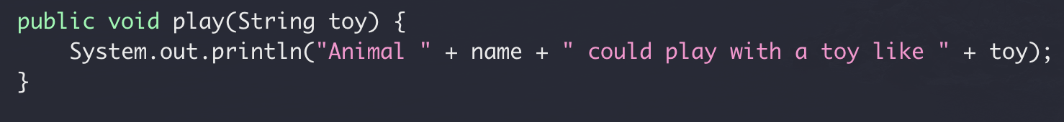
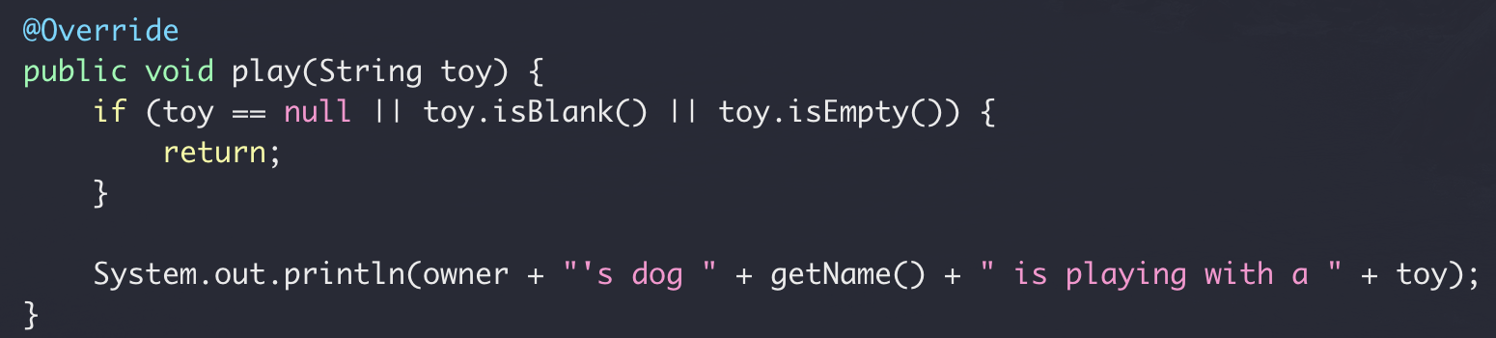
Override vs Overload
Override
Re-implement a function in derived class from base class with the
same name
same signature
Base class: Aniaml.Java
Derived class: Dog.Java

Slide 26
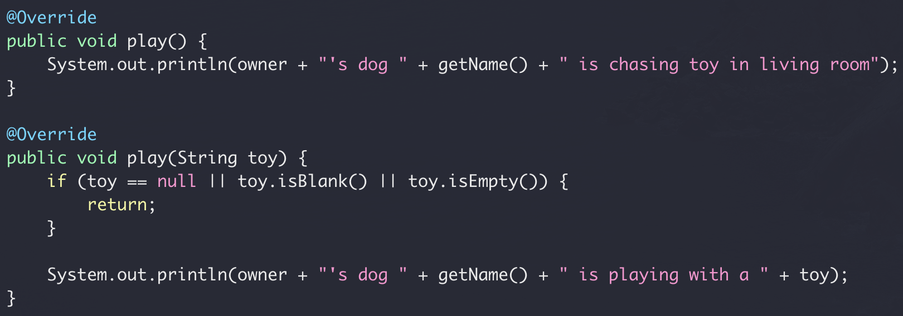
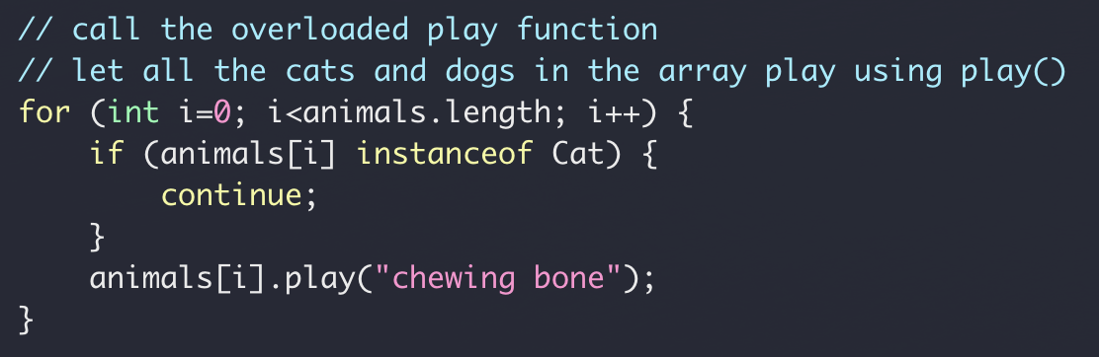
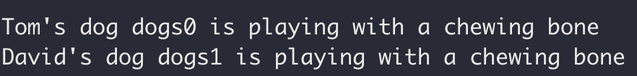
Override vs Overload
Overload
Re-implement a function in the same class
same name
different signature
Full code here
Derived class: Dog.Java

Slide 27
Inheritance Summary
Base class & derived class
Use super to access the base
Override vs Overload

Slide 28
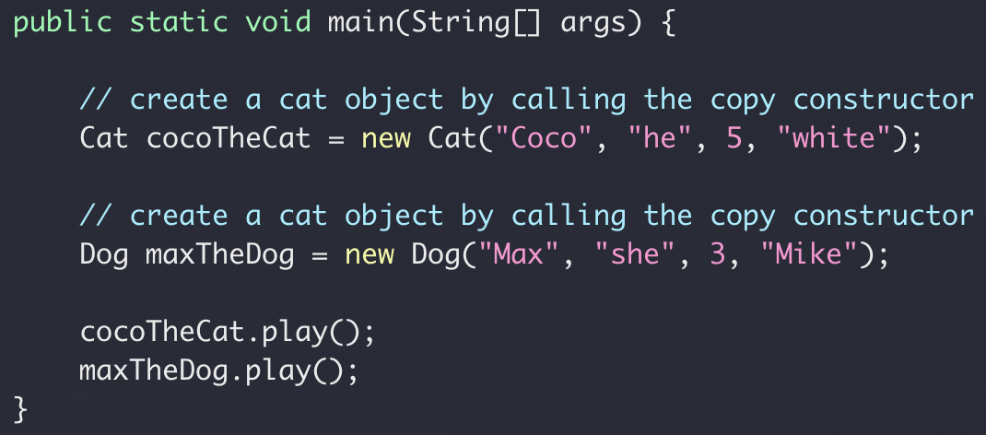
Class Exercise
Let all cats and dogs play
What if we have 300 cats and 200 dogs?
What if we have 3 cats and 2 dogs?

Slide 29
Polymorphism
Animal Class
public void play()
Dog Class
Cat Class
public void play()
public void play()

Slide 30
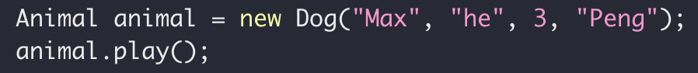
Polymorphism
Dog Instance
Assignment
Animal reference
public void play()

Slide 31
Polymorphism
Cat Class
Assignment
Animal reference
public void play()

Slide 32

Polymorphism
Same reference type (base class), different objects (derived class)
“late binding”

Slide 33
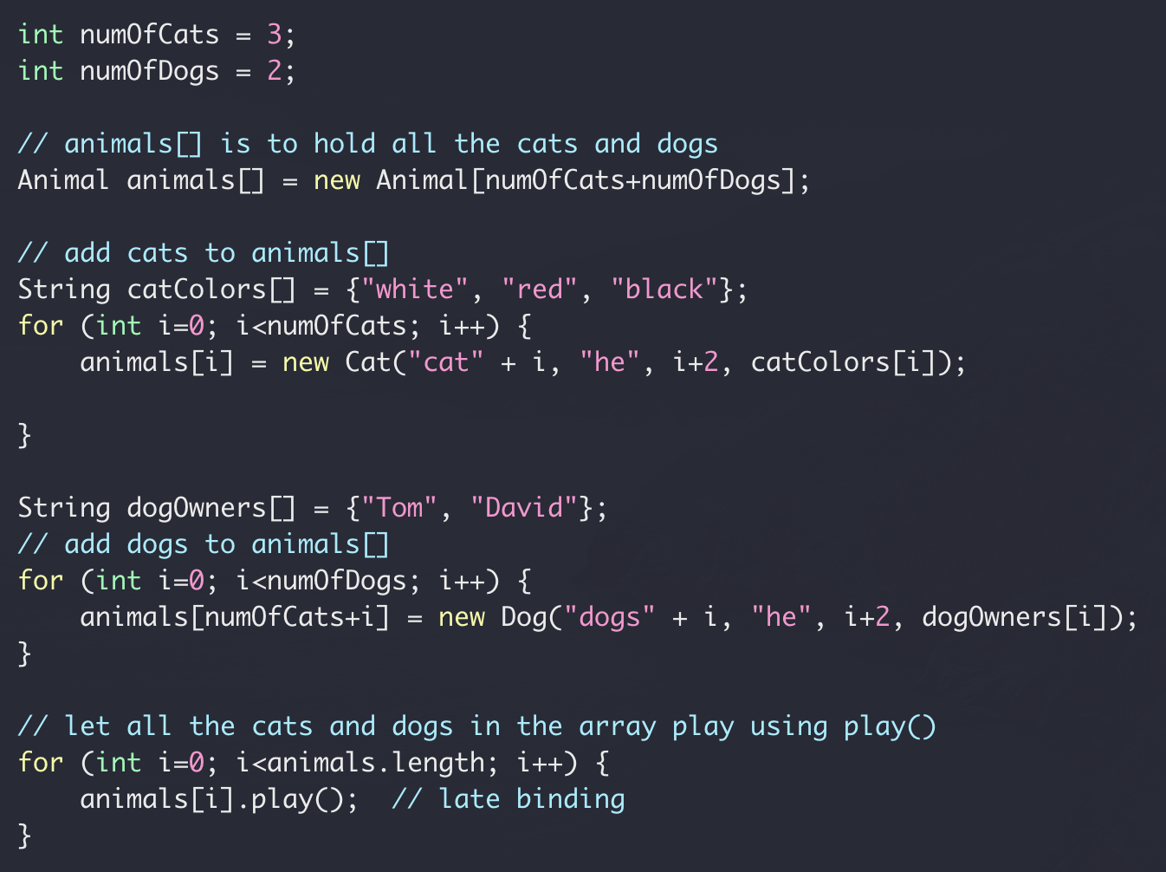
Polymorphism

Slide 34
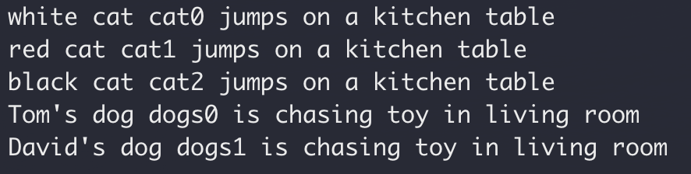
Polymorphism
Full code here (version 2)

Slide 35
Polymorphism Summary
Overridden method
Access using base class instance reference
Late binding: actual method being invoked is determined at run time
A more amusing example here

Slide 36
Abstract Class
Animal Class
public void play()
public void play()
No need to implement
Dog Class
Cat Class
Dog Class
Cat Class
public void play()
public void play()
public void play()
public void play()

Slide 37
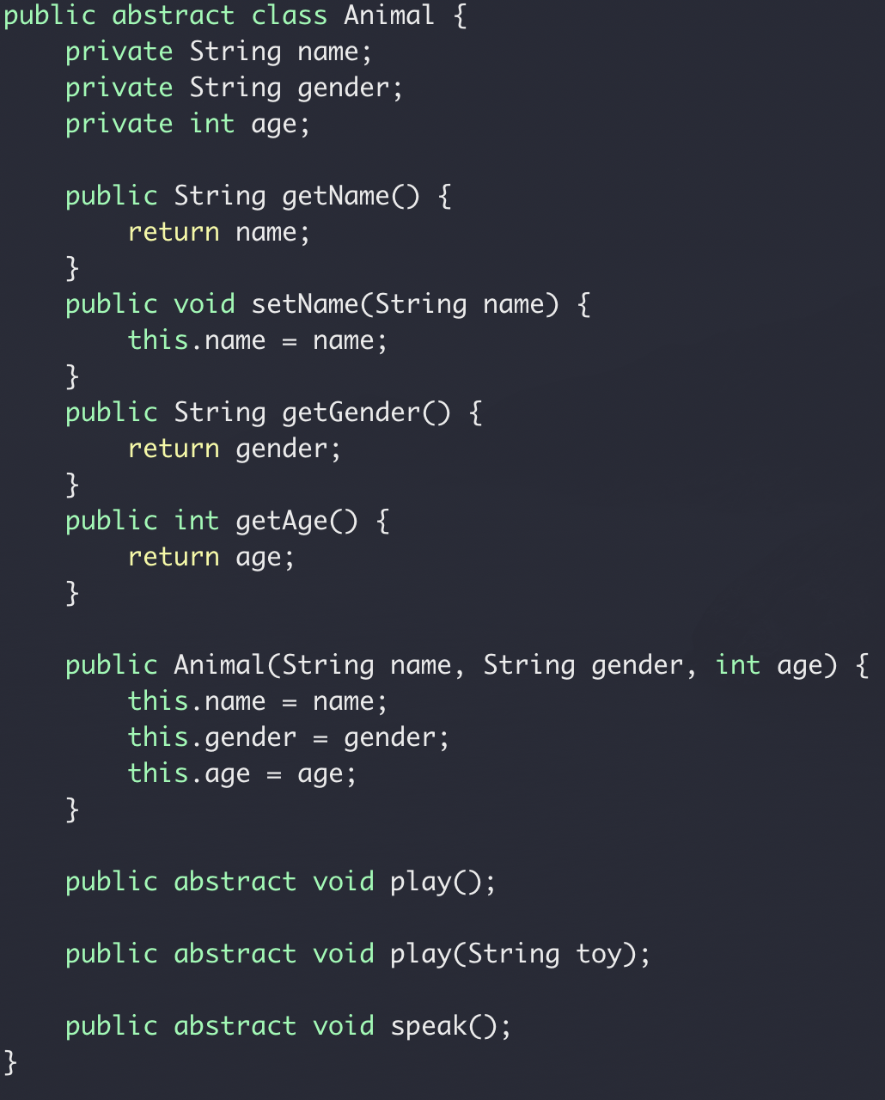
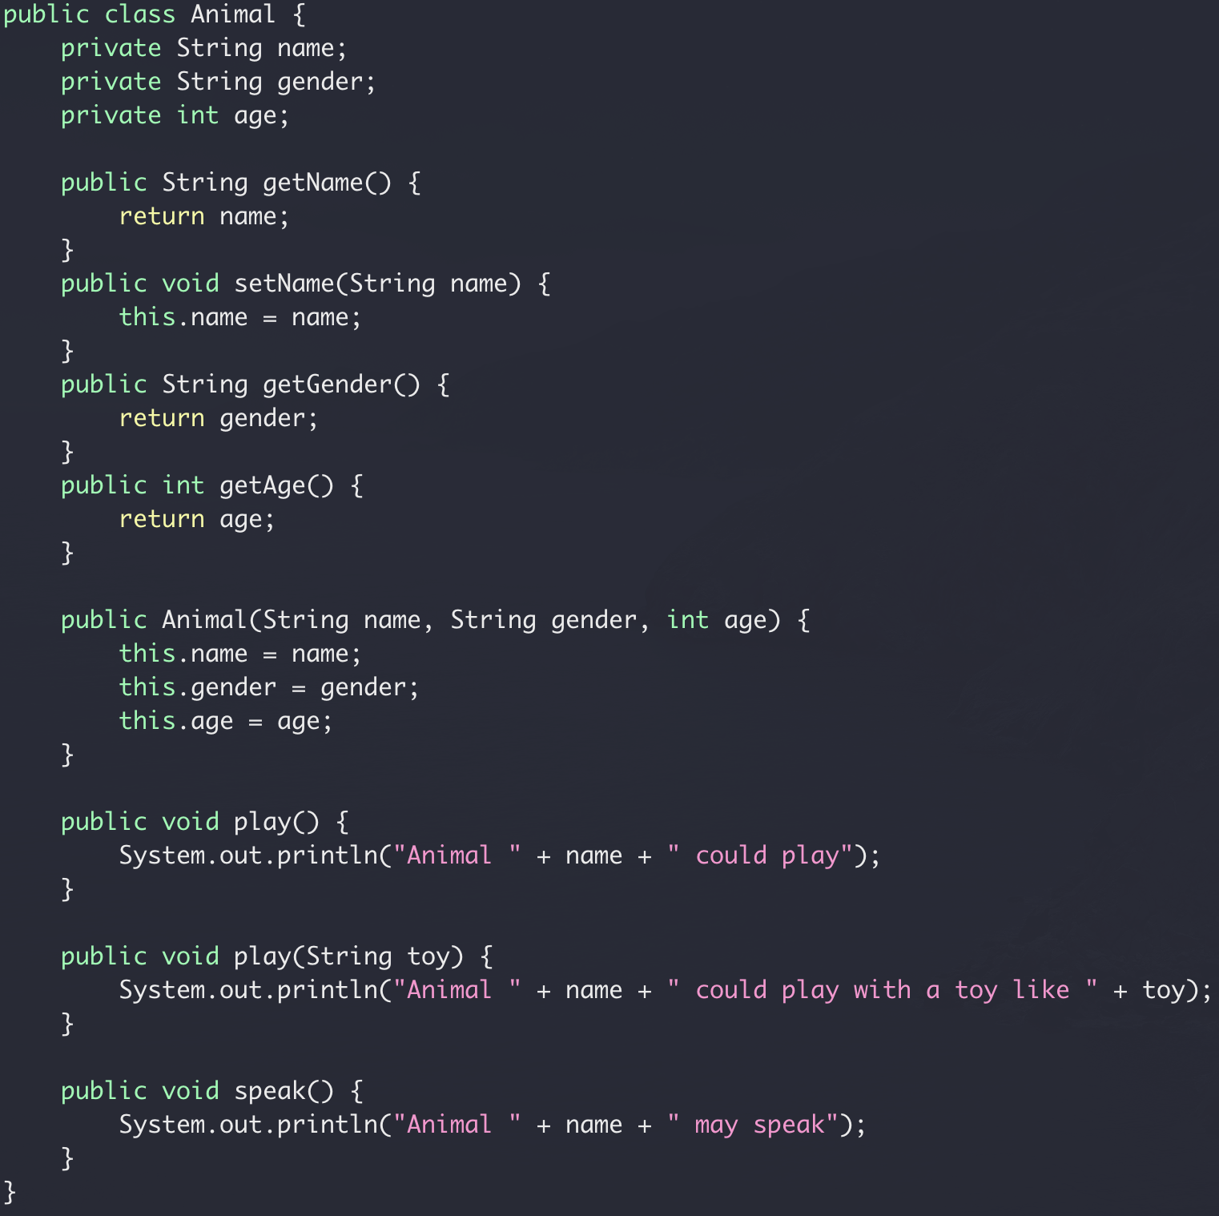
Abstract class
Full code here version 4

